Slide 1
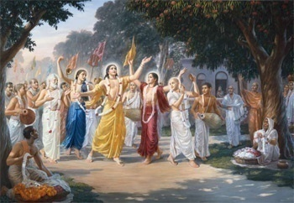
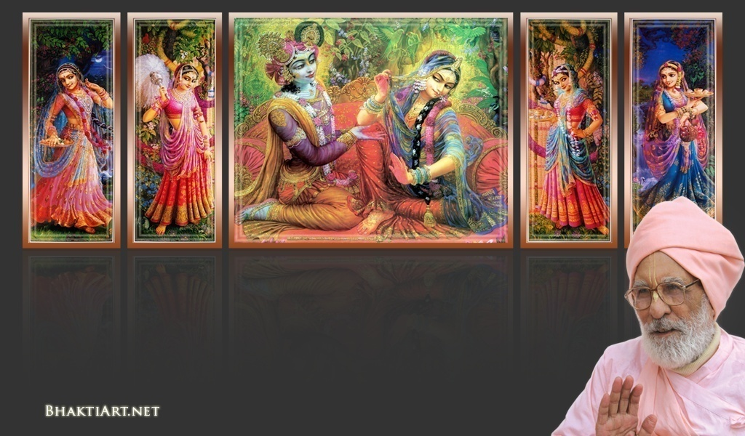
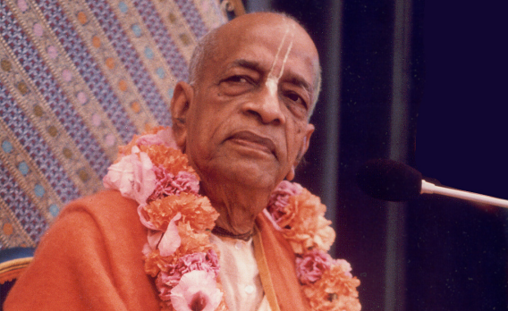
Sri Krsna Caitanya Prabhu Nityananda
Sri Advaita Gadadara Srivasadi
Gaura Bhakta Vrinda
Hare Krsna Hare Krsna
Krsna Krsna Hare Hare
Hare Rama Hare Rama
Rama Rama Hare Hare
Gokul Bhajan & Vedic Studies
North Carolina, USA
Notes:
Om Ajnana timirandhasya, jnananjana salakaya
Caksur unmimiltam yena, tasmai sri gurave namah
Namah om vishnu padaya, radhikayah priyatmane
Sri-srimad bhaktivedanta, narayana iti namine
Sri krishna lila kathane sudaksham
Audarya-madhurya gunais ca yuktam
Varam varenyam purusham mahantam
Narayanam tvam sirasa namami
He krishna karuna sindho, dina bandho jagat pate
Gopesha gopika kanta, radha kanta namo ‘stu te
tapta kancana gaurangi, radhe vrindavaneshvari
vrsabhanu sute devi, pranamami hari priye
bhajami radham aravinda netram
smarami radham madhurasmi-tasyam
vadami radham karuna bharardram
tato mam anyasti gatir na kapi
bhaktya vihina aparadha lakshai
ksiptas ca kamadi taranga madhye
krpamayi tvam saranam prapanna
vrinde numas te caranara vindam

Slide 2
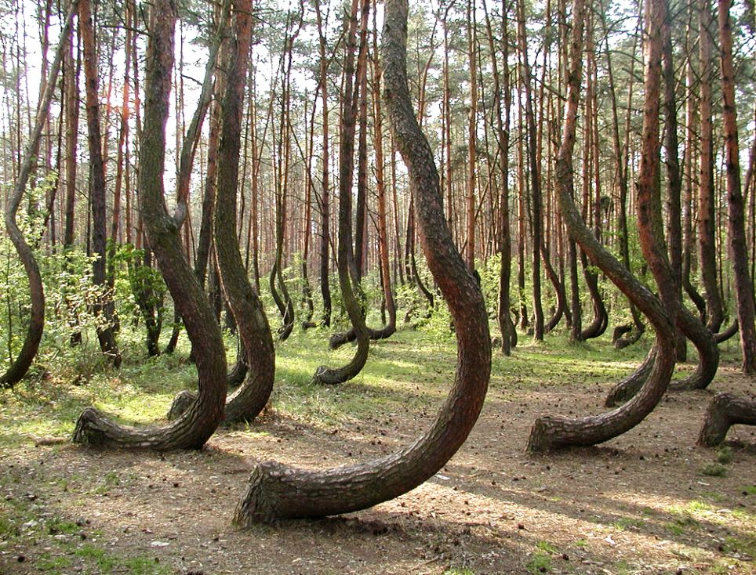
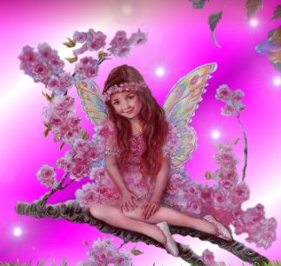
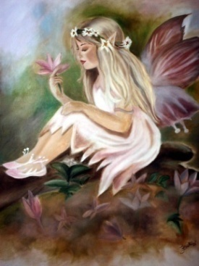
Do you know why all these trees are so crooked? ..and called fairy trees?

Slide 3
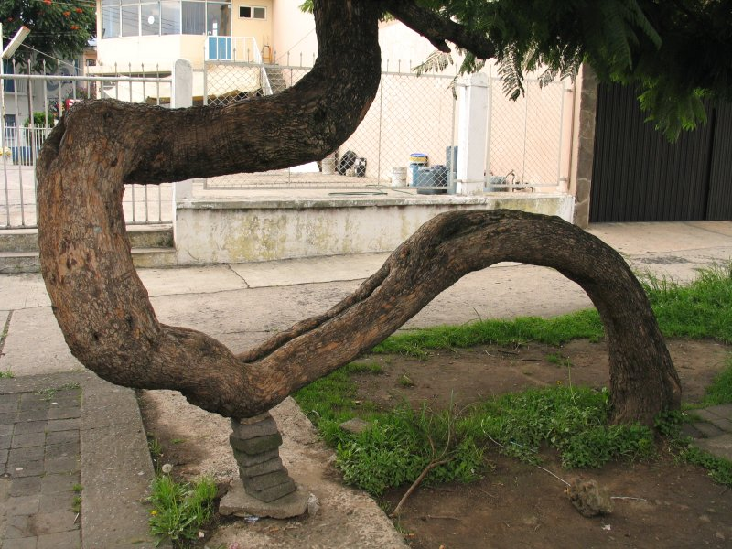

Slide 4
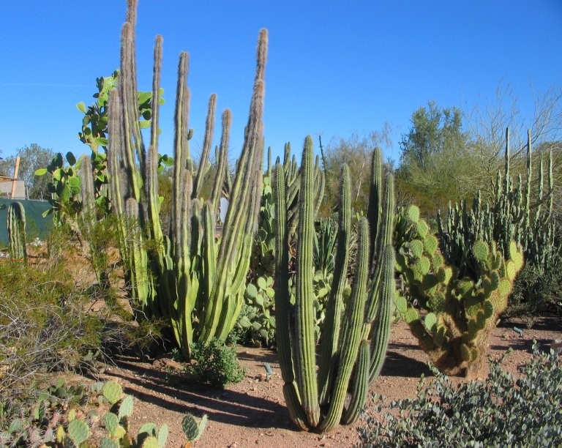
Once
upon
a
time
…
There was a big garden!
with full of harmful thorn trees!

Slide 5
One day, a tiny mysterious seed fell in at a corner

Slide 6
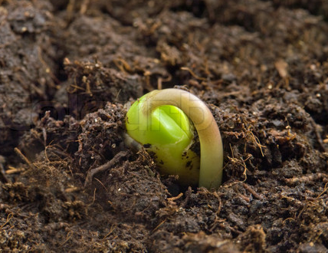
When a rare rain came, it sprouted..

Slide 7
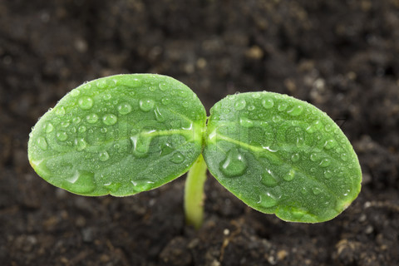
And started as a very tiny plant…

Slide 8
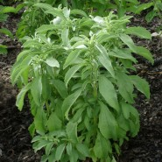
Then it was growing..
No one noticed..

Slide 9
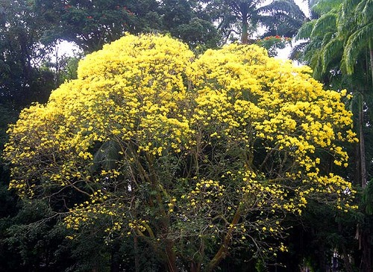
But it grew and grew, pushing & knocking every other plant out.!.

Slide 10
It systematically sabbataged and killed every other plant!

Slide 11
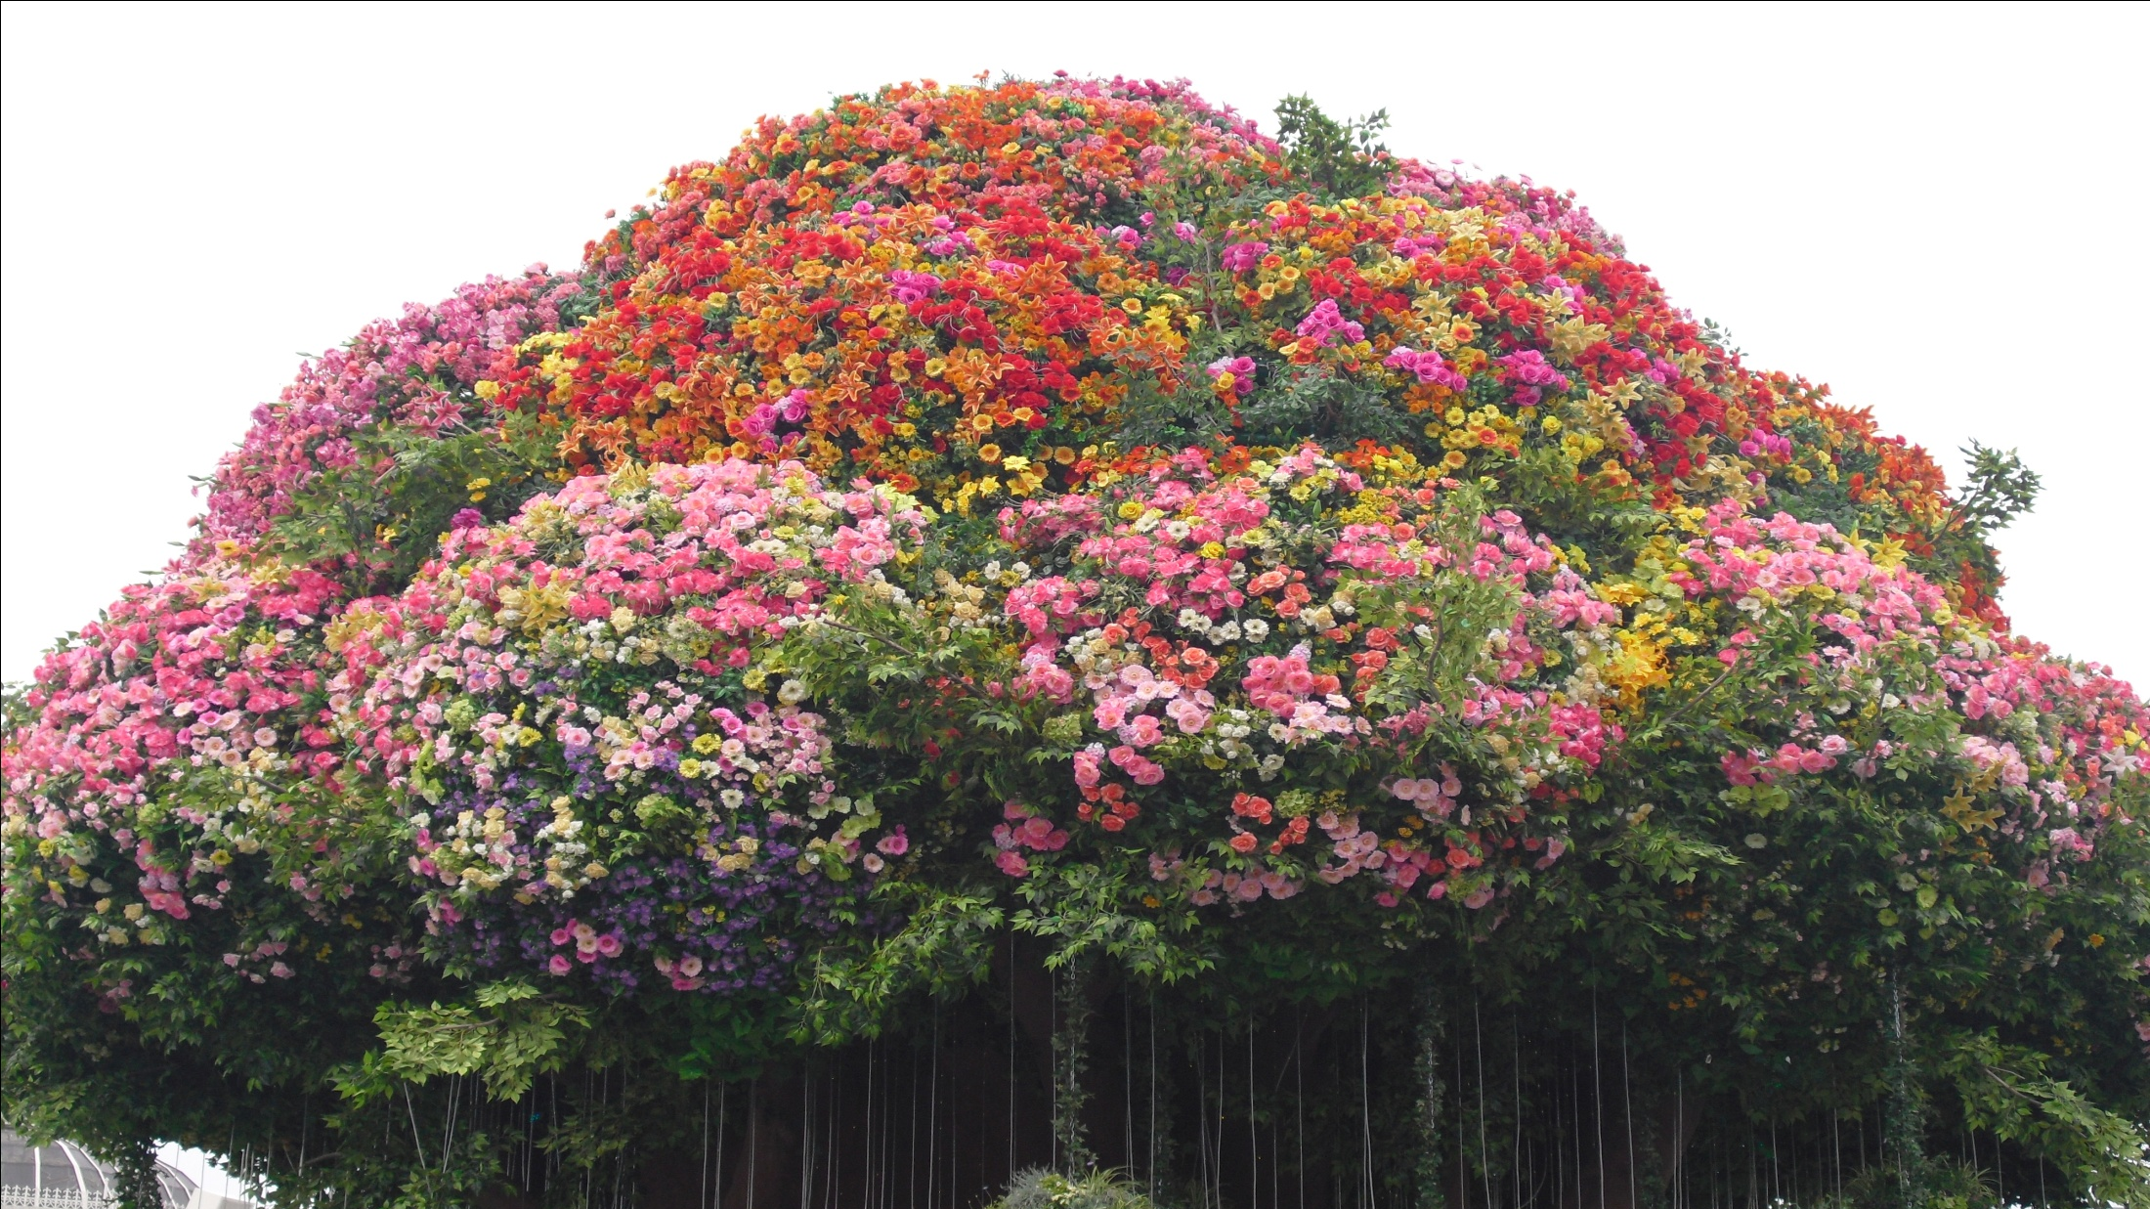
...until it made that it is the only one in the whole space!
What a power for a little seed!
It started as a tiny seed and now it is a whole forest of only itself!

Slide 12
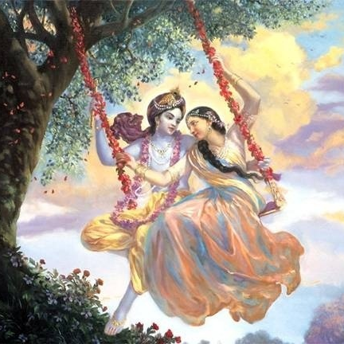
Jaya Rādha Mādhava
Jaya Kunja Vihārī
Jaya Gopī Jana Vallabha
Jaya Giri Vara Dhārī ... (Jaya)
Yaśodā Nandana Vraja Jana Ranjana
Yamunā tīra Vana Cāri ... (Jaya)
[ Hare Krishna Hare Krishna
Krishna Krishna Hare Hare
Hare Rāma Hare Rāma
Rāma Rāma Hare Hare ]

Slide 13
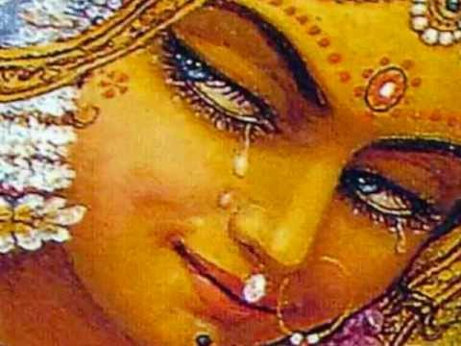
Week# 249
Jan 12, 2013
BHAKTI DEVI

Slide 14
The hearts of people are usually full of anarthas of thorn bushes!
EGO
Their bhakti if at all is mostly Karma Misra Bhakti..
Anartas take dominance and pushes..
Sensual Desires…
PRIDE
ENVY

Slide 15
But, for those who have sukrti, mercy comes in thru Maha Bhagavata..
EGO
A seed of pure bhakti from bhagavata falls into their heart…
Sensual Desires…
PRIDE
ENVY

Slide 16
Somehow, from a rashika bhakta, a seed of pure bhakti gets into one’s heart..

Slide 17
She then sprouts, grows and grows… killing every other desires!

Slide 18
Eventually every anartha is destroyed!

Slide 19
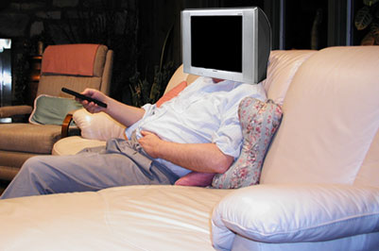
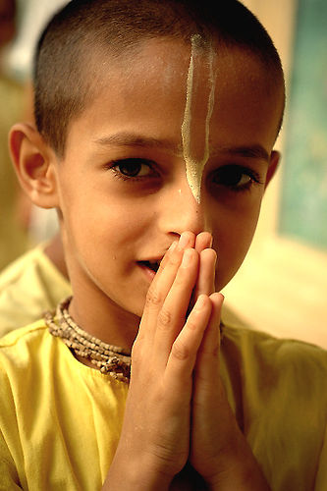
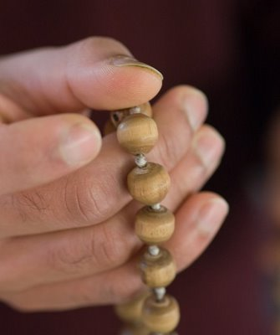
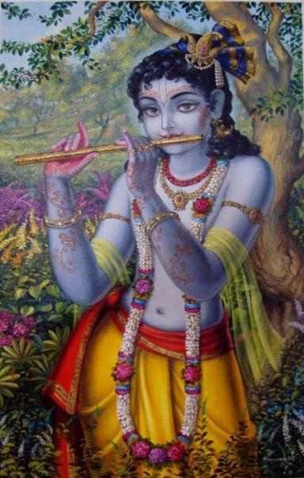
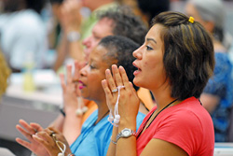
TV/Game Addiction..
Anarthas are uprooted!... One by One!
Gossiping

Slide 20
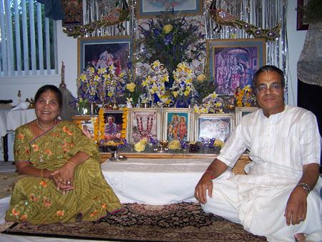
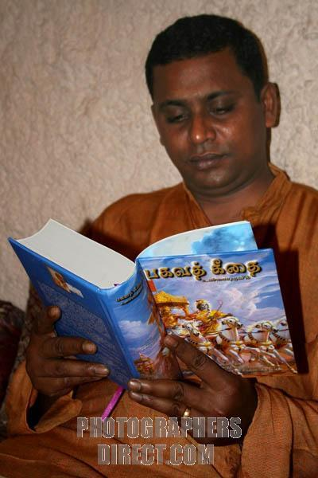
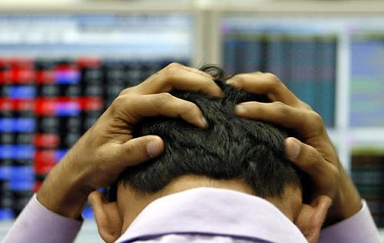
Every anartha is uprooted out!... One by One!
Party!
Stock Market!

Slide 21
In a matter of time, she systematically uproots and sabbotages everything else!

Slide 22
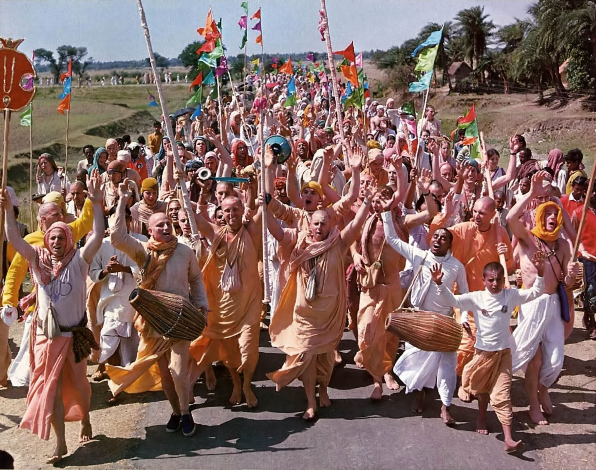
Now, your heart hangers for Hari Nama Sankirtan always!

Slide 23
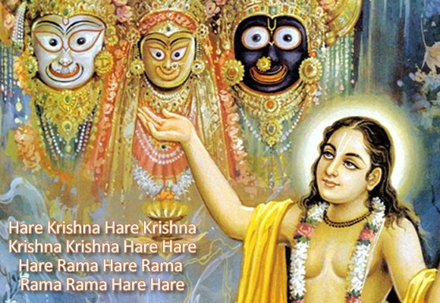
3 mins

Slide 24
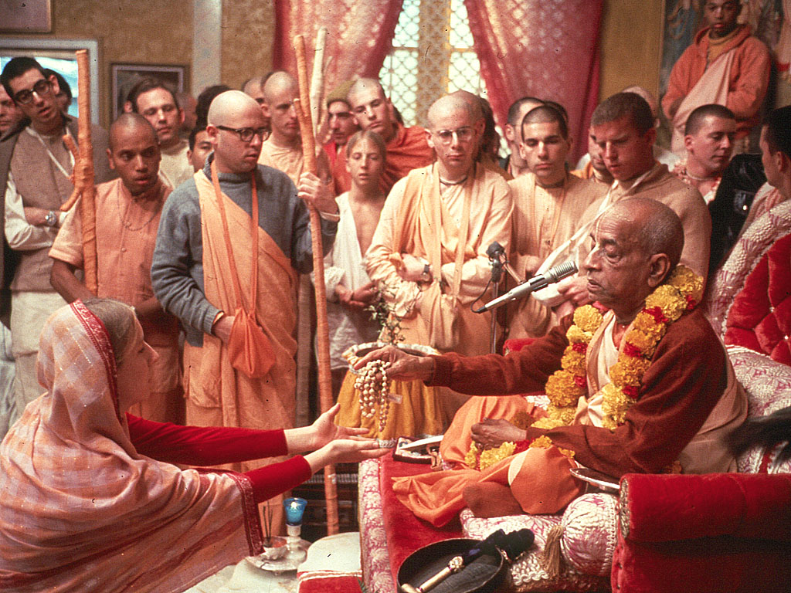
Later, by Caitanya Guru, that person happens to meet a bhagavata and hear from him!
Bingo!

Slide 25
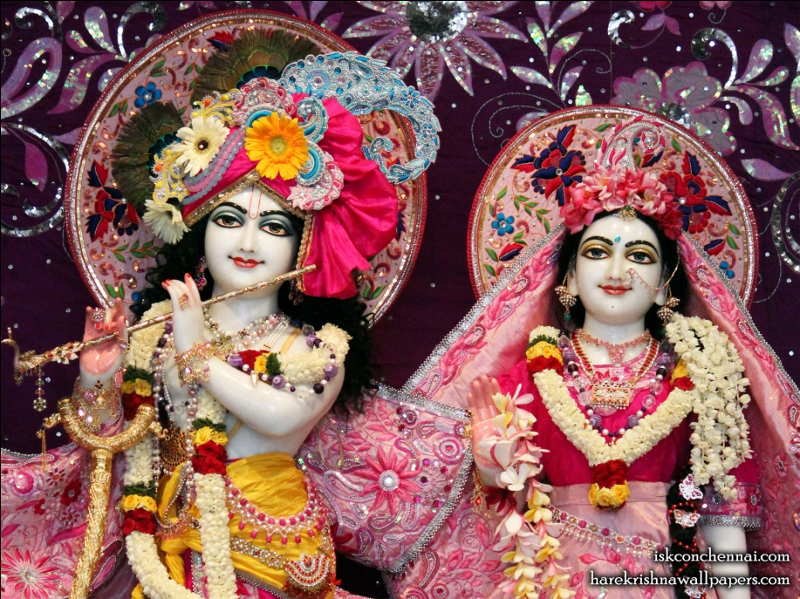
Sri Sri Radha & Krishna happily move in!
The soul now serves them ‘with’ Bhakti!

Slide 26
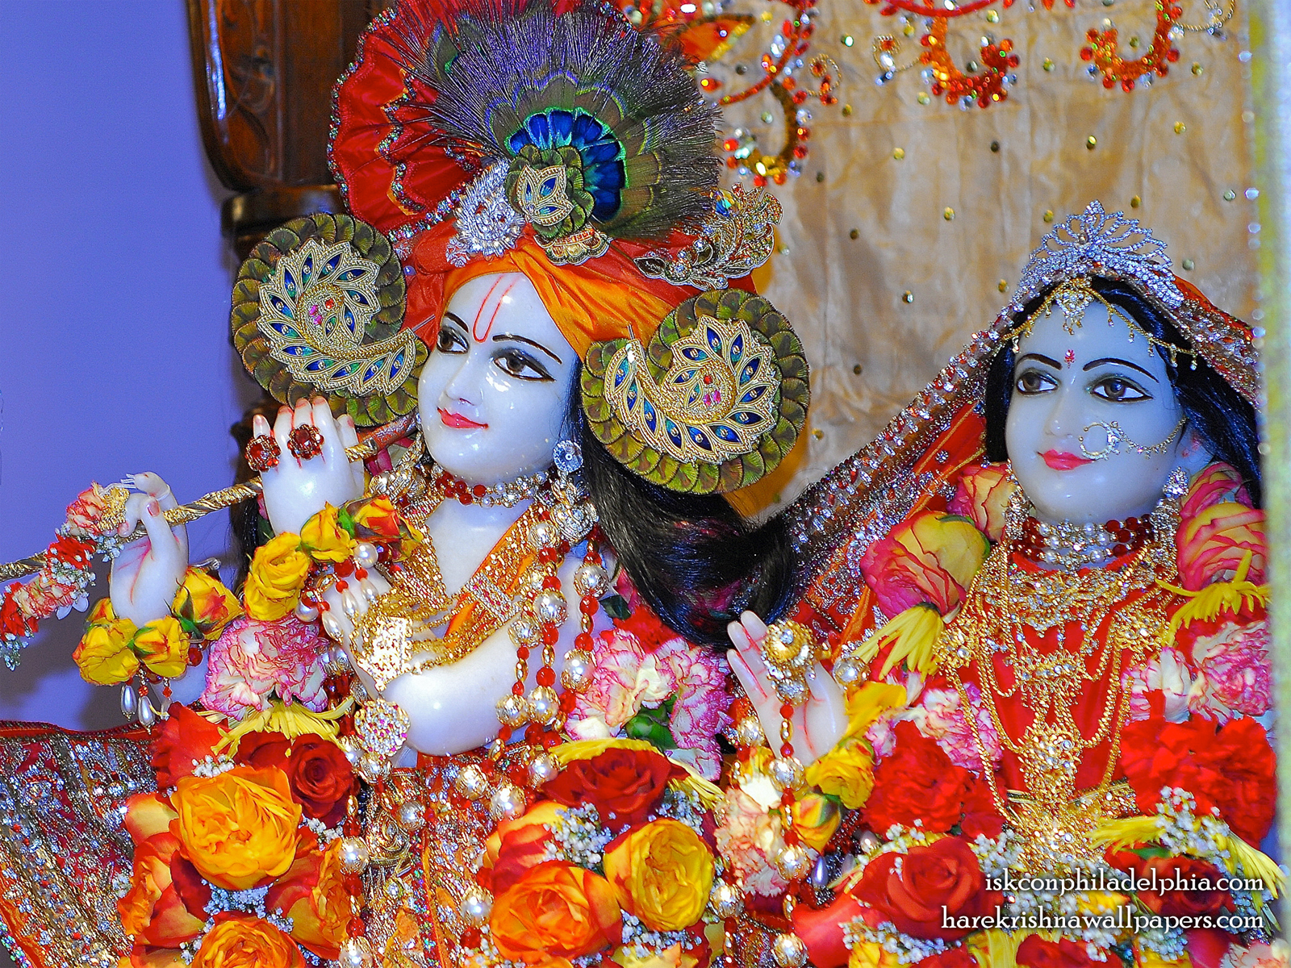
That Jiva then always sings the glories of Sri Shyama Sundara

Slide 27
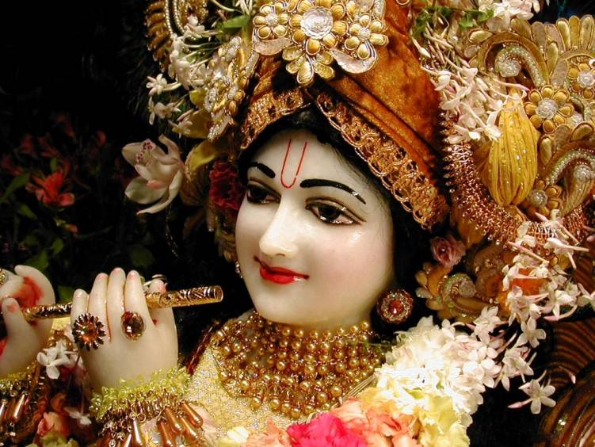
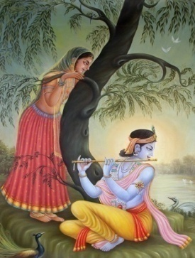
E-64
[O’ Shyamalā, O’ Sundarā
Cita Chorā Nanda Nandanā] ... (O Shyamala)
[O’ Mādhavā, Madhusūdhanā
Man Mana Mohanā Manmatā] ... (O Shyamala)
[O’ Keshavā, Giri Vardanā
Gopi Kāntā Yadhu Nandanā] ... (O Shyamala)
[O’ Vāmanā Vamsi Dhāraņā
Vana Mālā Hari Govindā!] ... (O Shyamala)

Slide 28
And… who is this Bhakti Devi?

Slide 29
Sastras are very limited to describe her unique identity!

Slide 30
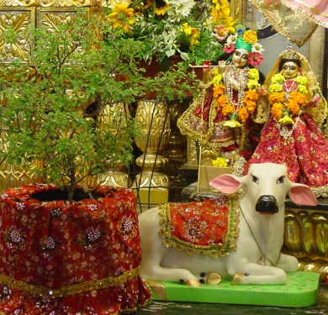
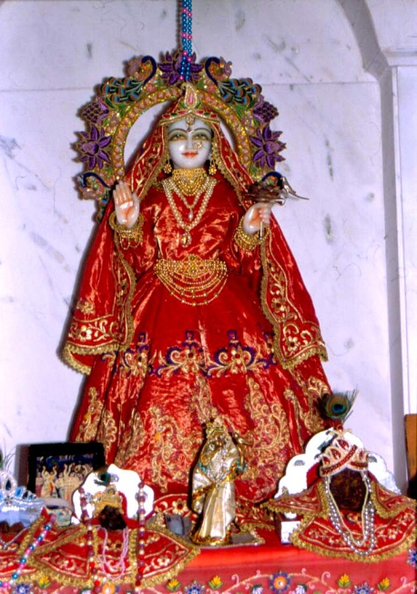
Vrindayai Tulasi Devyai
Priyayai Kesavasya Ca
Krsna Bhakti Prade Devi
Satya Vatye Namo Namah..

Slide 31
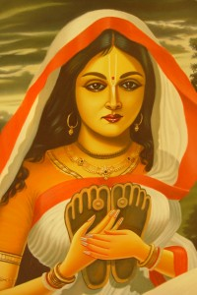
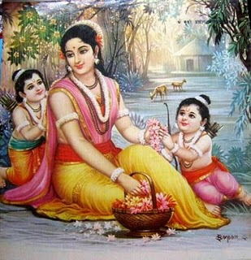
One of the incarnations of Bhakti Devi is:
Sri Vishnu Priya
Other is: Sri Sita Devi

Slide 32
Bhagavan Sri Krishna (and hence Sriman Narayana)
is accompanied by three Devis:
Sri Devi
Bhu Devi
Nila Devi (or Leela Devi)

Slide 33
In Caitanya Leela
Sri Devi → Laxmi Priya
(Consort of Gaura Narayana – Sri Ananta conducted the marriage.)
Bhu Devi → Vishnu Priya
(Sri Vanamali conducted the marriage (who also did for Satyabhama in Krsna Leela). Buddhimanta Khan paid marriage expenses)
Nila Devi → Nawadwip Dham

Slide 34
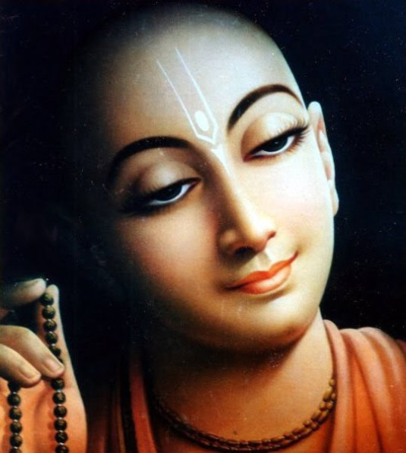
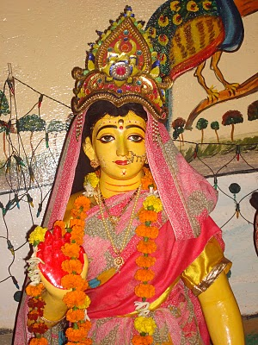
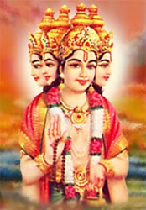
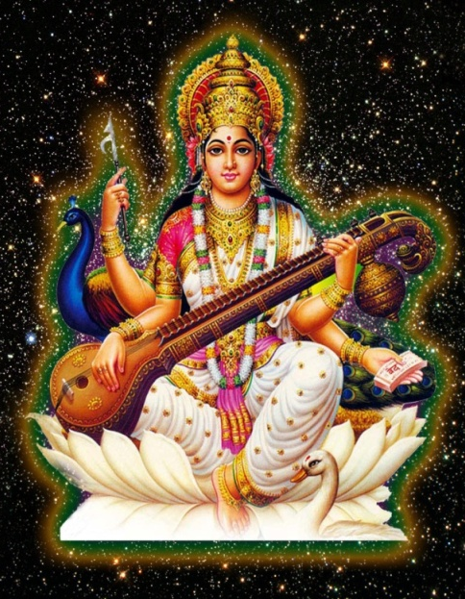
(BO-04)
ceto-darpaṇa-mārjanaḿ bhava-mahā
dāvāgni-nirvāpaṇaḿ śreyaḥ-kairava-candrikā-vitaraṇaḿ
vidyā-vadhū-jīvanam ānandāmbudhi-vardhanaḿ prati-padaḿ
pūrṇāmṛtāsvādanaḿ sarvātma-snapanaḿ paraḿ vijayate
śrī-kṛṣṇa-sańkīrtanam
2 kinds of Vidya
Para Vidya – Transcendental Knowledge
Apara Vidya- Material Knowledge

Slide 35
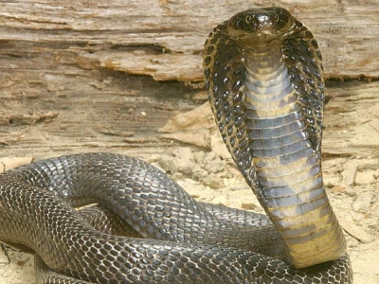
Lord Caitanya FIRST married Laxmi Priya (who is Sri Devi or Maha Laxmi) and later she died of snake bite. Why? Can’t Lord protect against this simple thing?

Slide 36
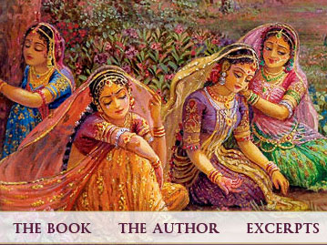
Gaura Leela the cornerstone of gaudiya is: Union in Separation

Slide 37
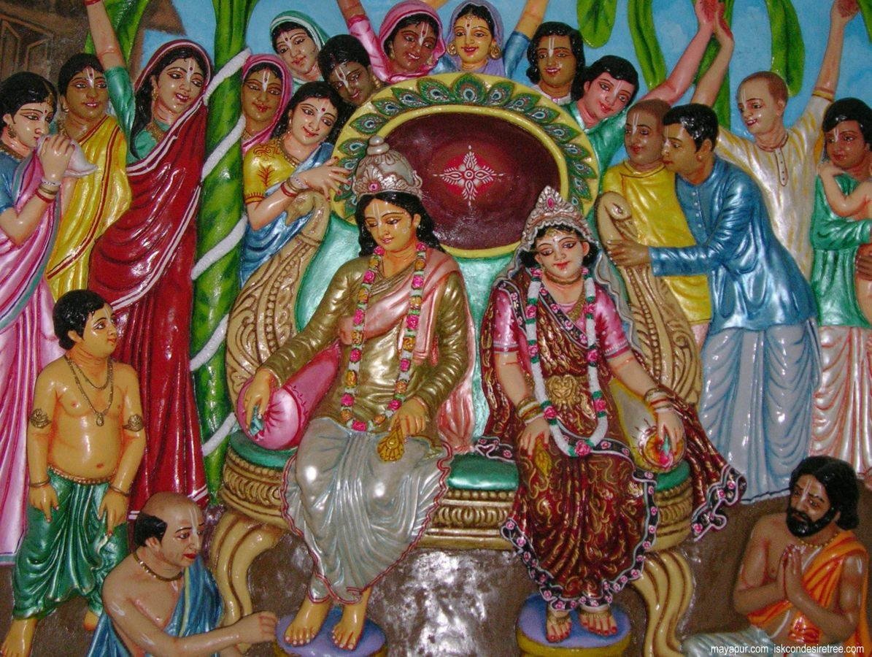
Lord Caitanya marries Vishnu Priya as his second wife…

Slide 38
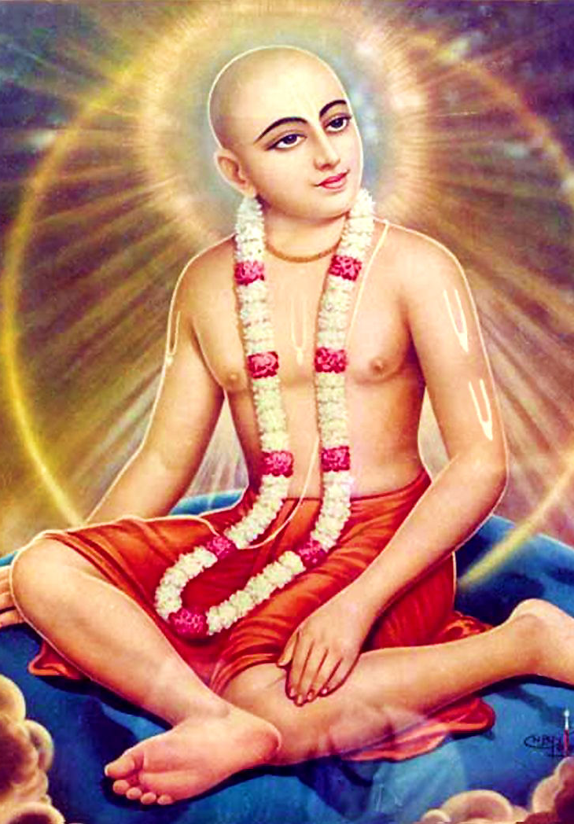
Then Caitanya decides to take sannyas…
Vishnu Priya comes to know..

Slide 39
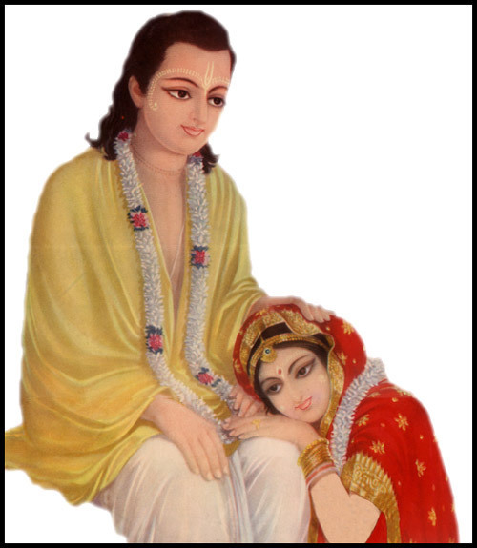
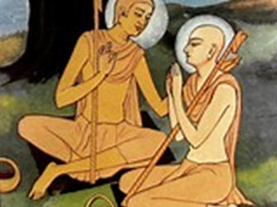
She felt as if hit by a powerful thunderbolt...

Slide 40
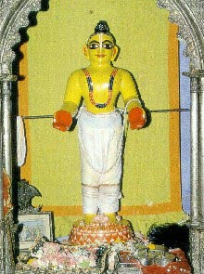
Lord Caitanya gives a deity of himself made of Neem (Margosa)
Have you seen this type of deity anywhere?
Notes:
After Chaitanya Mahaprabhu took sannyasa and left for Puri Kshetra ,his wife Srimati Vishnupriya Devi began to pine away in seperation from her beloved .Mahaprabhu himself gave her a deity of his own self to comfort her . The deity was made of robust neem wood with two palms facing forward in a gesture of embrace or welcome . Vishnupriya began worshiping this deity in her home.

Slide 41
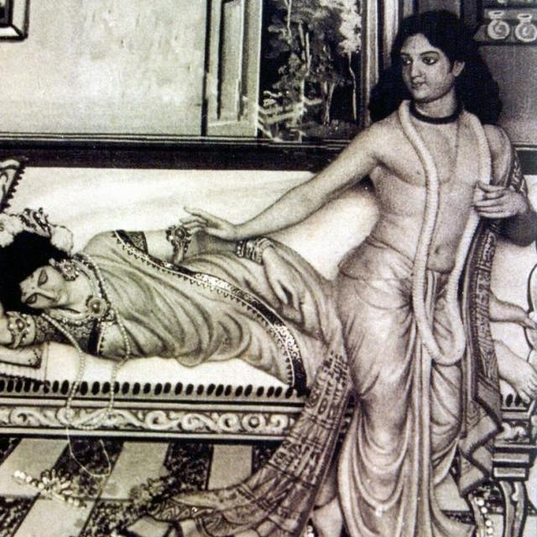
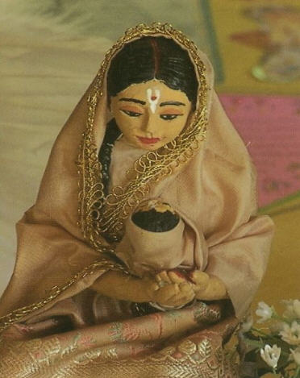
Sri Vishnu Priya
Sri Saci Mata

Slide 42
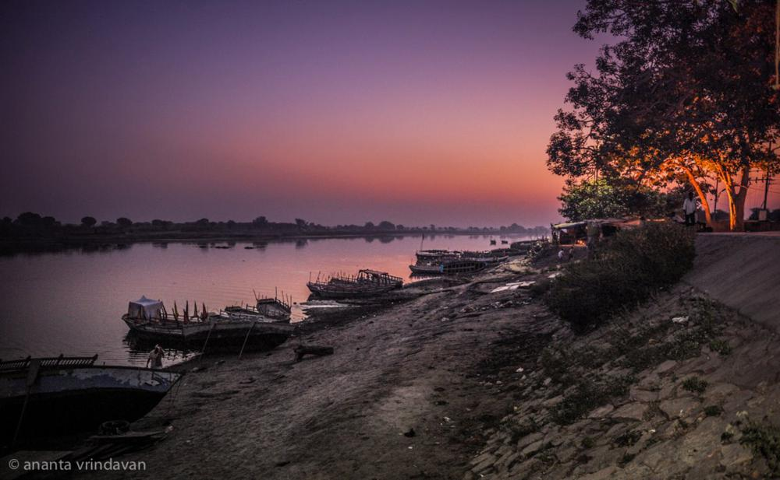
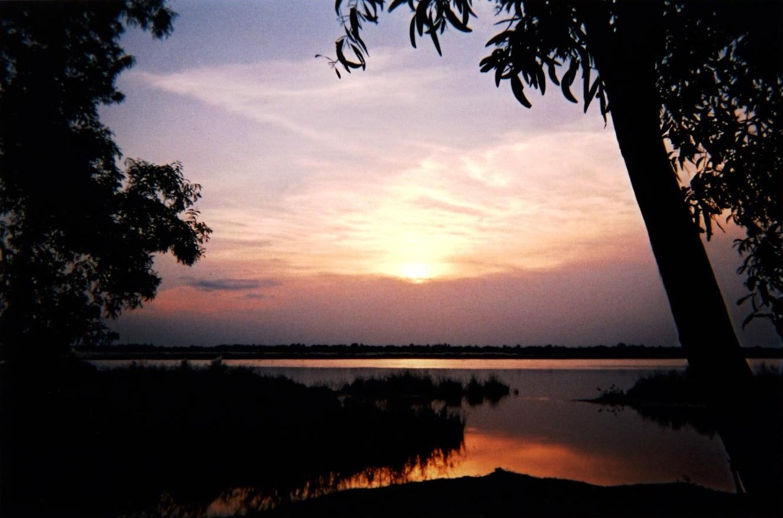
It was about 3:00 am in the morning…
Lord Caitanya swam across the Ganges..

Slide 43
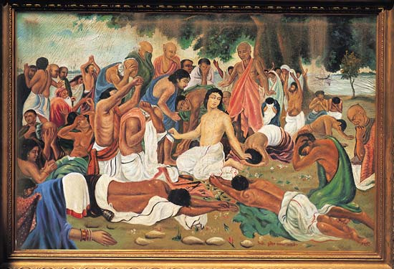
Sri Caitanya Mahaprabhu takes sannyasa from Keshava Bharati

Slide 44
Everyone cried!
“Such a very young and beautiful man.. Why should he do this?..”
The barber took a oath while he wept, “I will leave my job for ever, and will not shave anyone any more!..”

Slide 45
Hare Krishna Hare Krishna
Krishna Krishna Hare Hare
Hare Rama Hare Rama
Rama Rama Hare hare

Slide 46
One day, while in Nawadwip, Lord Rama was smiling!

Slide 47
Caitanya showed how to cry for Sri Radha Krishna!
Vishnupriya showed how to cry of Lord caitanya!

Slide 48
At end, Vishnu Priya merged into this same deity we can see even today.. When she merging, her nose head ornament was stuck in the nose of the deity which we can see..
Dhaameshwar Gauranga , Navadwipa
Notes:
Towards the end of her life she is said to have merged into this very deity one morning after her daily puja .When the gates were opened people found her pearl nose bead hanging from the nose of Gauranga deity ! Today the same idol is carefully preserved by descendants of maternal side of Vishnupriya Devi , who are also its sevaks . The little pearl nose ring still hangs from his nose . And he is considered the lord of Navadwipa dhaam ... hence his name Dhaameshwar Gauranga . In the right side corner of the silver throne , in the front of the main deity one can see the original padukas of Chaitanya

Slide 49
And Lord Caitanya Maha Prabhu merged into the deity of Tota Gopinatha!

Slide 50
What are the prime residences of Bhakti Devi?
G1-04
Nāham vasāmi vaikuṇthe
Yoginām hrdayena ca
Mad-bhaktā yatra gāyanti
Tatra tiṣţhāmi Nārada .........
(Padma Purāṇa)
Notes:
Towards the end of her life she is said to have merged into this very deity one morning after her daily puja .When the gates were opened people found her pearl nose bead hanging from the nose of Gauranga deity ! Today the same idol is carefully preserved by descendants of maternal side of Vishnupriya Devi , who are also its sevaks . The little pearl nose ring still hangs from his nose . And he is considered the lord of Navadwipa dhaam ... hence his name Dhaameshwar Gauranga . In the right side corner of the silver throne , in the front of the main deity one can see the original padukas of Chaitanya

Slide 51
D-20
Jaya jaya sundara nanda-kumāra (2)
Saurabha-sańkaţa-vṛndāvana-taţa
Vihita-vasanta-vihāra ......... (Jaya)
Abhinava-kuţmala-guccha-samujjvala
Kuñcita-kuntala-bhāra ......... (Jaya)
Praṇayi janerita-vandana-sahakṛta
Cūrṇita-vara-ghana-sāra ......... (Jaya)
Caţula-dṛg-añcala-racita-rasoccala
Rādhā-madana-vikāra ......... (Jaya)
Bhuvana-vimohana-mañjula-nartana
Gati-valgita-maṇi-hāra ......... (Jaya)
Adhara-virājita-mandatara-smita
Locita-nija-parivāra ......... (Jaya)
Nija-vallabha-jana-suhṛt-sanātana
Citta-viharadavatāra ......... (Jaya)

Slide 52
A-06.1
Kṛpā koro vaiṣṇava ṭhākura,
sambandha jāniyā
Bhajite bhajite, abhimāna hau dūra..
'Āmi to vaiṣṇava', e buddhi hoile,
amānī nā ho'bo āmi
Pratiṣṭhāśā āsi', hṛdoya dūṣibe,
hoibo niraya-gāmī
Tomāra kińkora, āpane jānibo,
'guru'-abhimāna tyaji'
Tomāra ucchiṣṭha, pada-jala-reṇu,
sadā niṣkapaṭe bhaji

Slide 53
A-06.2
Kṛpā koro vaiṣṇava ṭhākura,
sambandha jāniyā
Bhajite bhajite, abhimāna hau dūra..
'Nije śreṣṭha' jāni, ucchiṣṭthādi dāne,
ho'be abhimāna bhāra
Tāi śiṣya tava, thākiyā sarvadā,
nā loibo pūjā kā'ra
Amānī mānada, hoile kīrtane,
adhikāra dibe tumi
Tomāra caraṇe, niṣkapaṭe āmi,
kāńdiyā luṭibo bhūmi

Slide 54
Vaishnava Thakura Ki Jay!
Bhakti Devi Ki Jay!
Thank You!

Slide 55
Sri Krsna Caitanya Prabhu Nityananda
Sri Advaita Gadadara Srivasadi
Gaura Bhakta Vrinda
Hare Krsna Hare Krsna
Krsna Krsna Hare Hare
Hare Rama Hare Rama
Rama Rama Hare Hare
THANK YOU!
Notes:
Om Ajnana timirandhasya, jnananjana salakaya
Caksur unmimiltam yena, tasmai sri gurave namah
Namah om vishnu padaya, radhikayah priyatmane
Sri-srimad bhaktivedanta, narayana iti namine
Sri krishna lila kathane sudaksham
Audarya-madhurya gunais ca yuktam
Varam varenyam purusham mahantam
Narayanam tvam sirasa namami
He krishna karuna sindho, dina bandho jagat pate
Gopesha gopika kanta, radha kanta namo ‘stu te
tapta kancana gaurangi, radhe vrindavaneshvari
vrsabhanu sute devi, pranamami hari priye
bhajami radham aravinda netram
smarami radham madhurasmi-tasyam
vadami radham karuna bharardram
tato mam anyasti gatir na kapi
bhaktya vihina aparadha lakshai
ksiptas ca kamadi taranga madhye
krpamayi tvam saranam prapanna
vrinde numas te caranara vindam

